Slide 1
Can language representations emerge from a purely image-pretrained model?
COSI133A – Graph Mining
Graph Few-shot Learning
-- An initial exploration in multimodal learning:
Look Twice as Much as You Say: Scene Graph Contrastive Learning for Self-Supervised Image Caption Generation,
CIKM’22, Chunhui Zhang, et al.
Chunhui Zhang
Language representations emerge from a purely image-pretrained model
Notes:
This section, cover edge-level data efficient learning for three types of graph mining tasks.

Slide 2
Look Twice as Much as You Say
Introduction
Introduction - vision language learning
Method
Experiment
Discussion
Chunhui Zhang
Language representations emerge from a purely image-pretrained model
Notes:
This section, cover edge-level data efficient learning for three types of graph mining tasks.

Slide 3
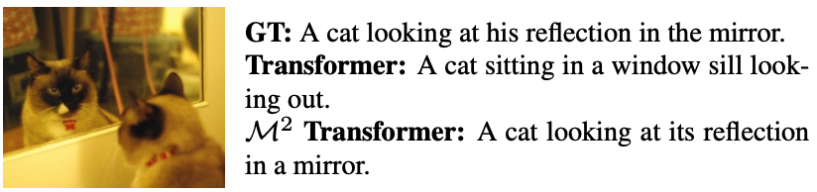
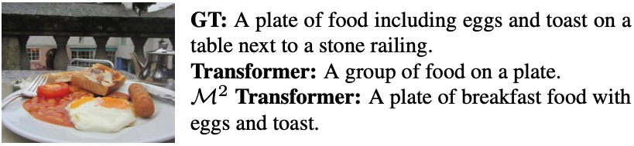
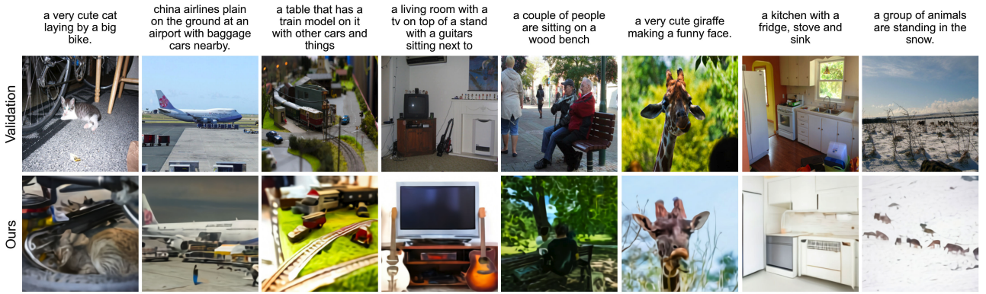
Introduction - Vision Language Learning
Introduction
1. Image2Text (e.g., M^2 Transformer)
2. Text2Image (e.g., Ramesh et al. (2021b).)
Chunhui Zhang
Language representations emerge from a purely image-pretrained model
Notes:
This section, cover edge-level data efficient learning for three types of graph mining tasks.

Slide 4
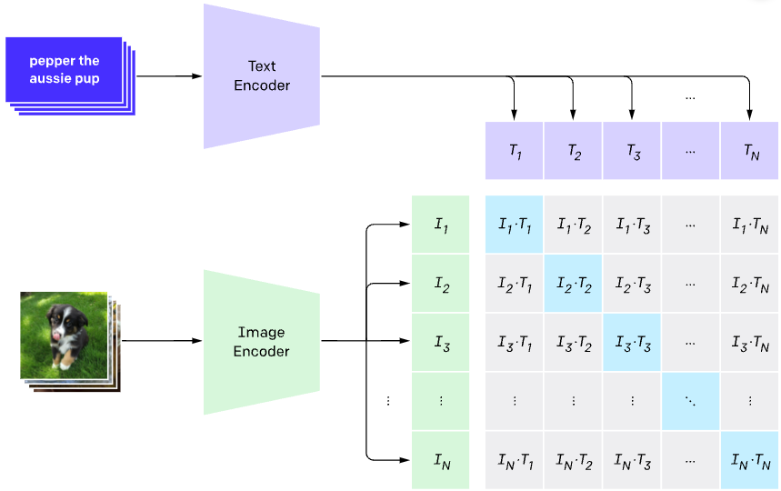
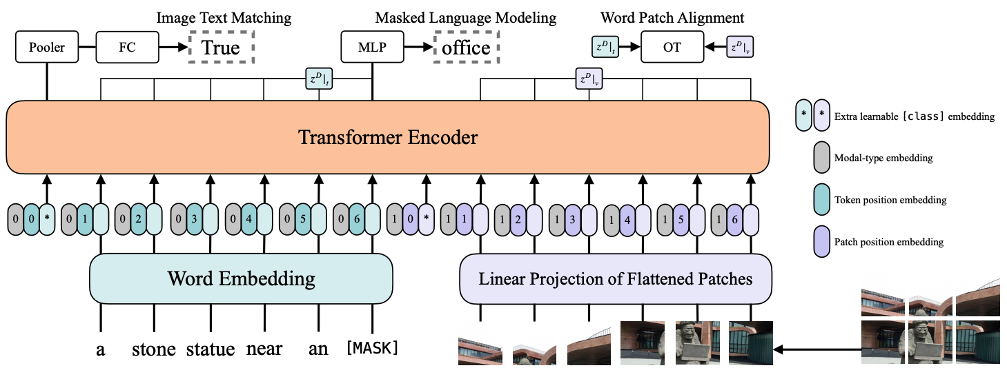
Introduction - Vision Language Learning
Introduction
3. Models for both modalities (e.g., CLIP, ViLT)
(a) CLIP
(b) ViLT
Chunhui Zhang
Language representations emerge from a purely image-pretrained model
Notes:
This section, cover edge-level data efficient learning for three types of graph mining tasks.

Slide 5
Introduction – Vision-Language Learning
Introduction
Summary:
Method 1 requires ground-truth text for supervised loss
Method 2 requires ground-truth image for supervised loss
Method 3 requires well-paired image-text input for (un)supervised loss
All three of the above popular cross-modal learning paradigms have limitations on the training data,
to mitigate the large modality gap between vision and speech.
To tackle these limitations, we start with a question
in image caption generation:
Can language representations emerge from a purely image-pretrained model?
Chunhui Zhang
Language representations emerge from a purely image-pretrained model
Notes:
This section, cover edge-level data efficient learning for three types of graph mining tasks.

Slide 6
Look Twice as Much as You Say
Introduction
Introduction - vision language learning
Method - Scene Graph Contrastive Learning
Experiment
Discussion
Chunhui Zhang
Language representations emerge from a purely image-pretrained model
Notes:
This section, cover edge-level data efficient learning for three types of graph mining tasks.

Slide 7
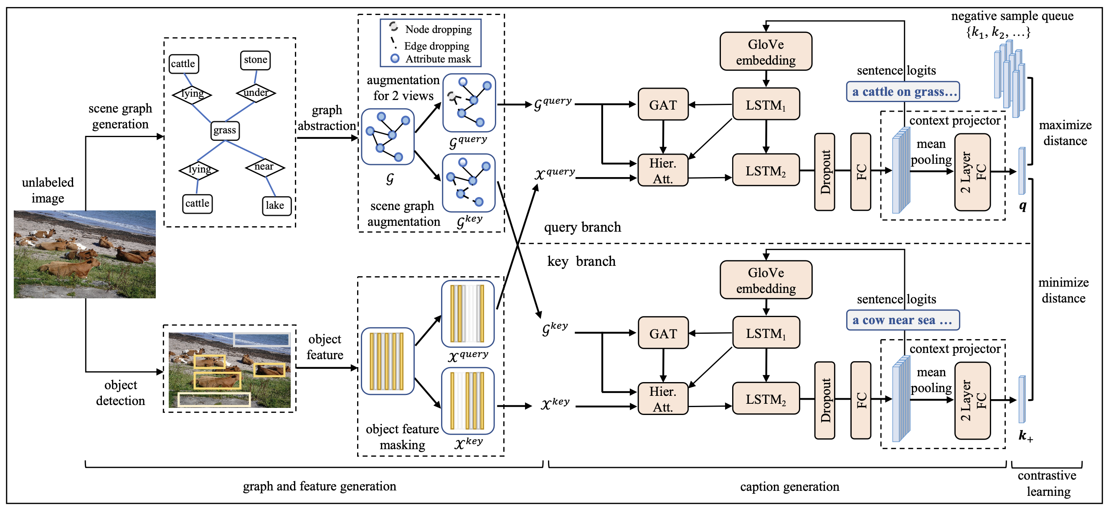
Method – Scene Graph Contrastive Learning
Introduction
Contrastive training with purely visual Inputs, to learn (pseudo) caption sentence generation
Chunhui Zhang
Language representations emerge from a purely image-pretrained model
Notes:
LSTM_1 -> Hier Att -> GAT -> Hier Att -> LSTM_2

Slide 8
Look Twice as Much as You Say
Introduction
Introduction - vision language learning
Method - Scene Graph Contrastive Learning
Experiment - effectiveness of emerged language representations in image-pretrained model on captioning
Discussion
Chunhui Zhang
Language representations emerge from a purely image-pretrained model
Notes:
This section, cover edge-level data efficient learning for three types of graph mining tasks.

Slide 9
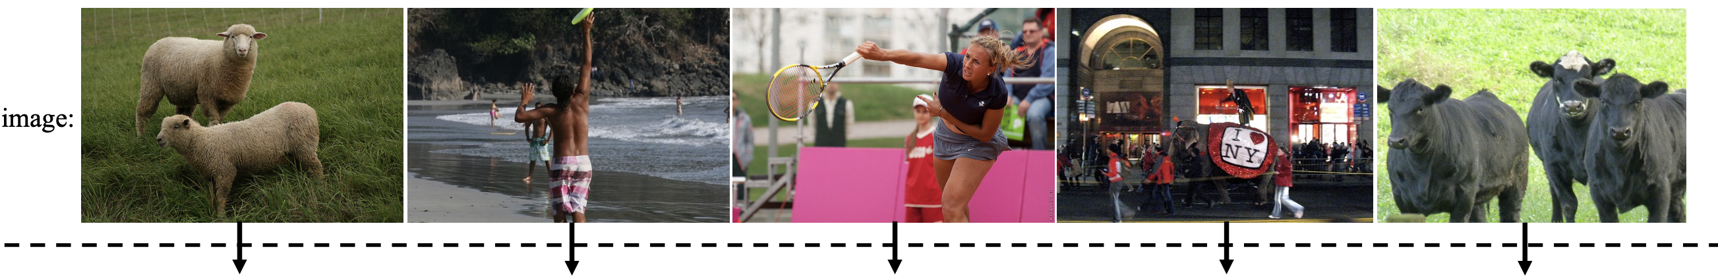
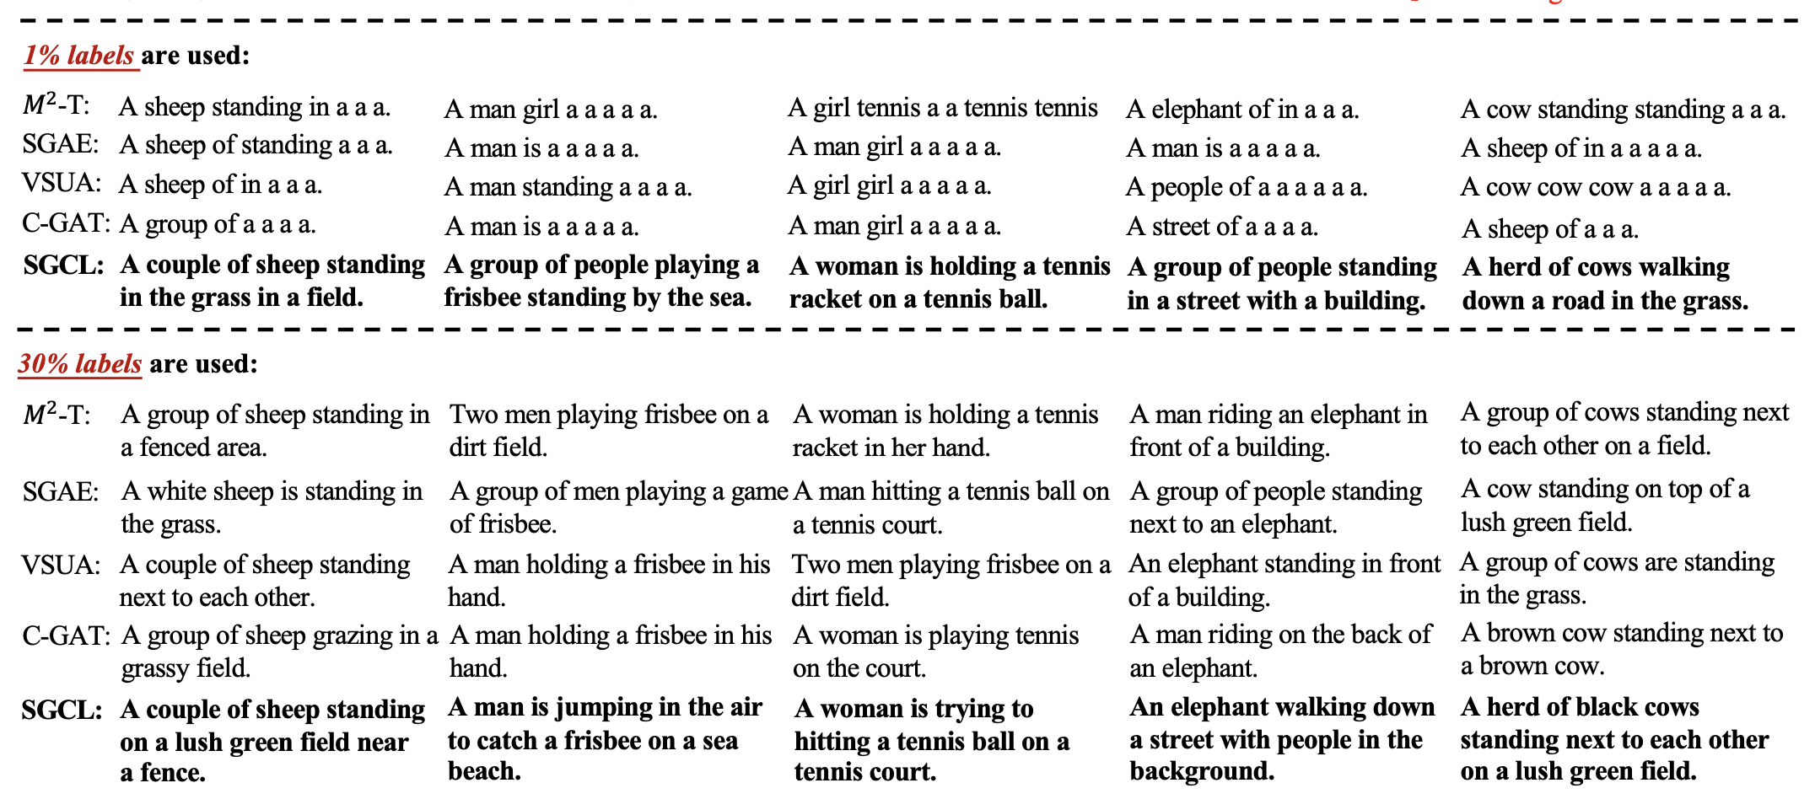
Experiment – Effectiveness of emerged language representations
Introduction
Performance: finetuning with very few ground-truth captions
Chunhui Zhang
Language representations emerge from a purely image-pretrained model
Notes:
LSTM_1 -> Hier Att -> GAT -> Hier Att -> LSTM_2

Slide 10
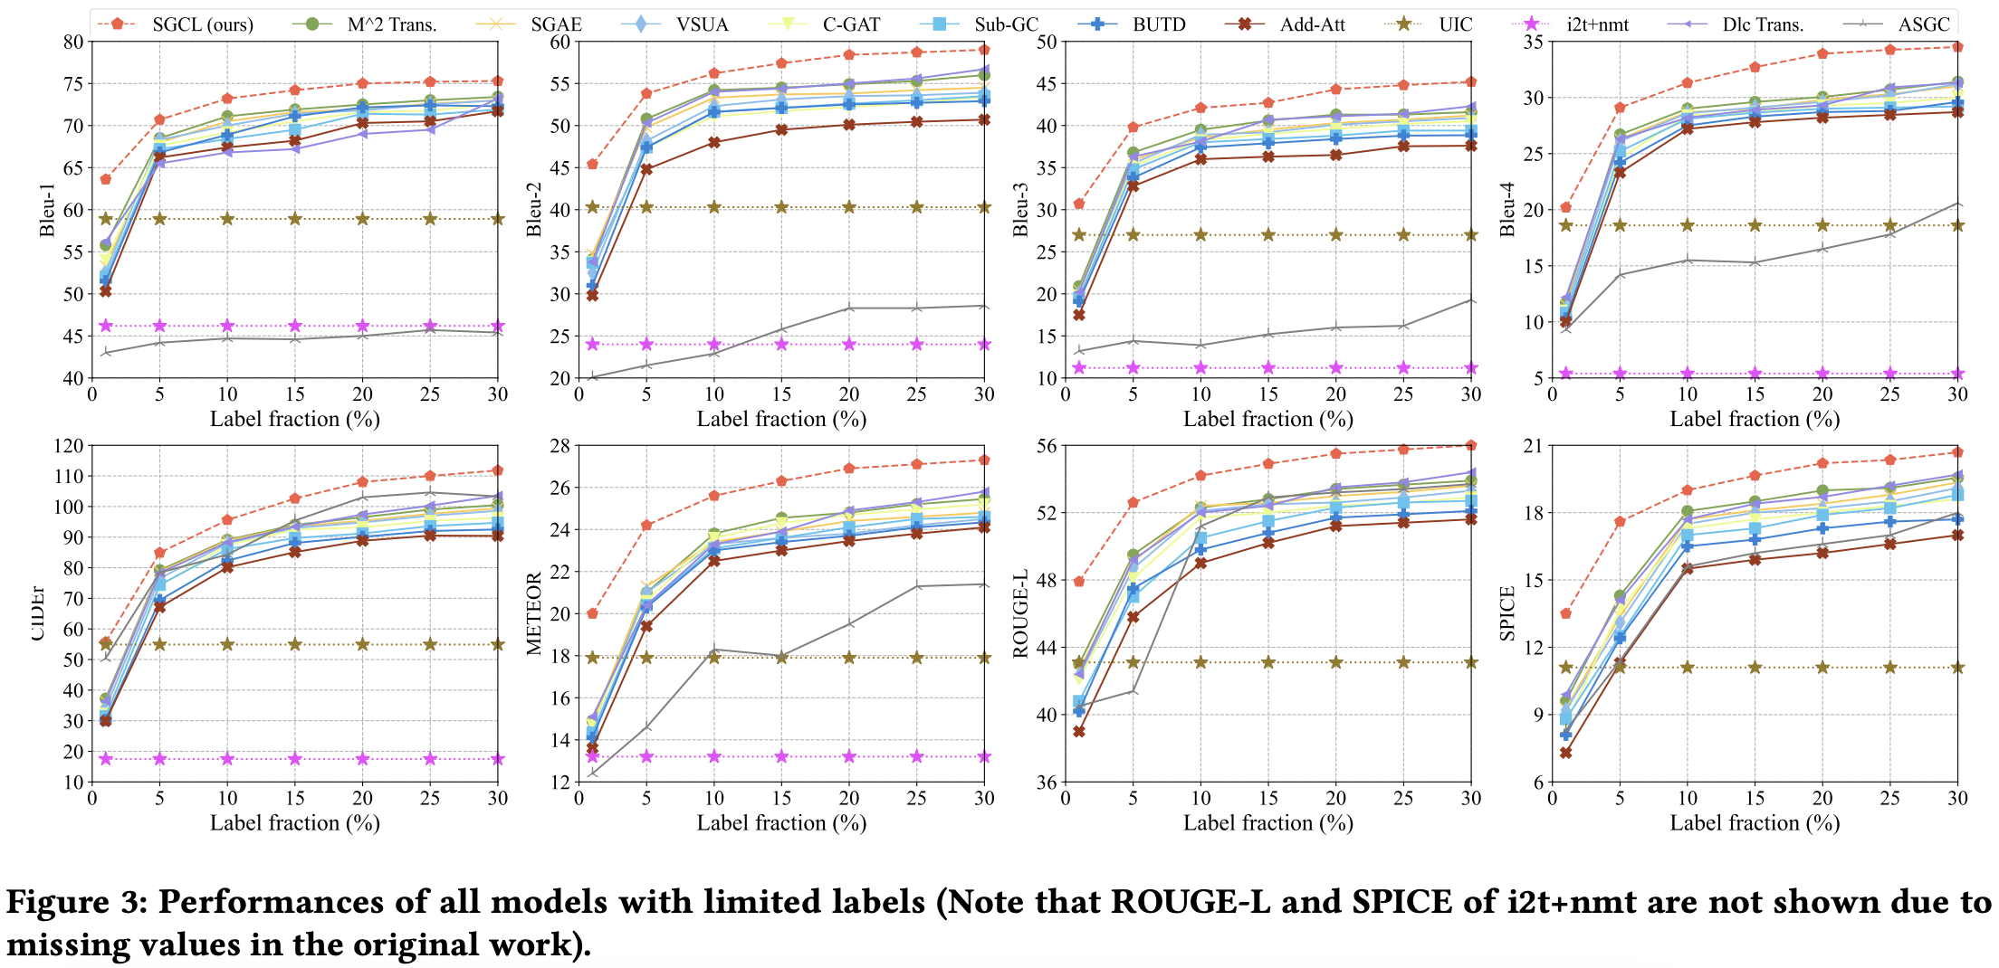
Experiment – Effectiveness of emerged language representations
Introduction
Comparisons with popular baselines in numerical metrics
Chunhui Zhang
Language representations emerge from a purely image-pretrained model
Notes:
LSTM_1 -> Hier Att -> GAT -> Hier Att -> LSTM_2

Slide 11
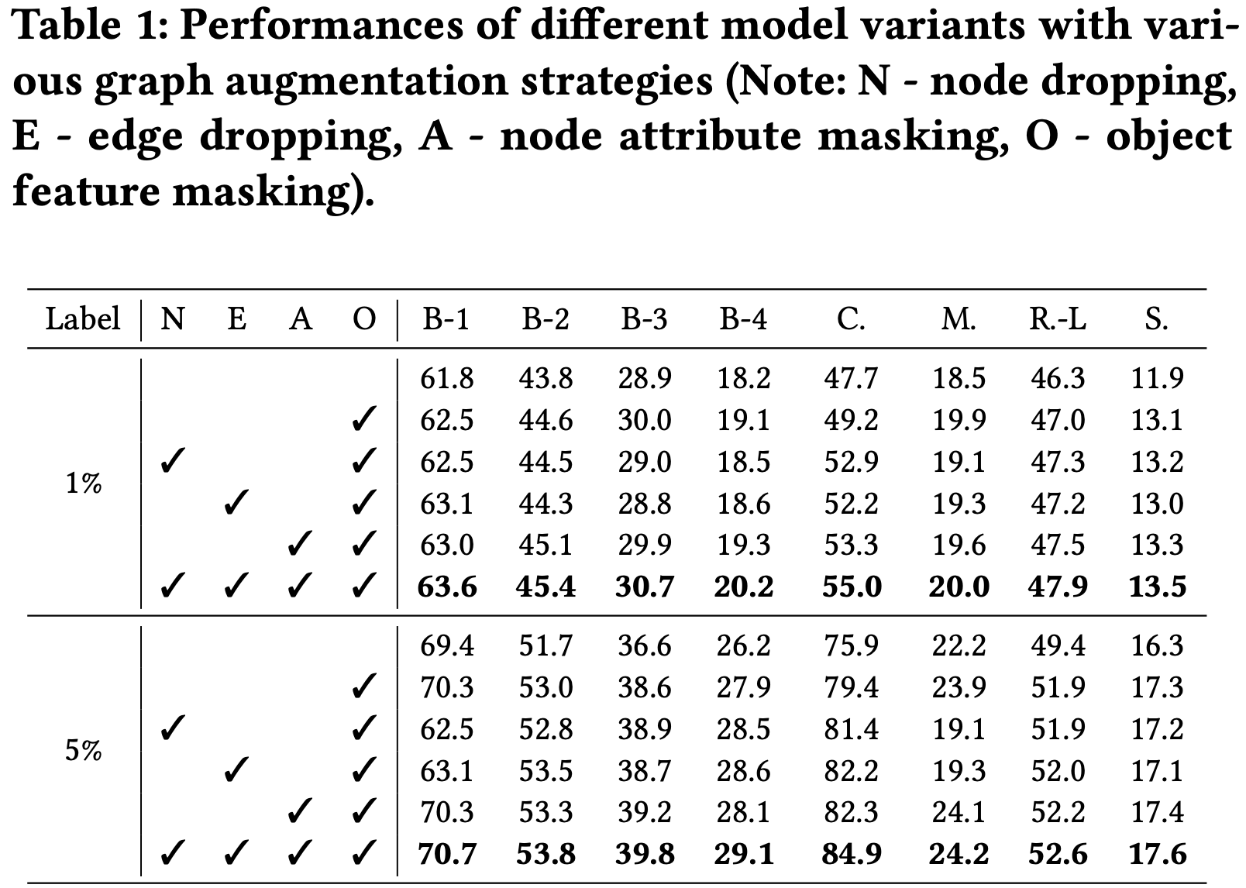
Experiment – Effectiveness of emerged language representations
Introduction
Ablation study on scene graph augmentation in contrastive learning
Chunhui Zhang
Language representations emerge from a purely image-pretrained model
Notes:
LSTM_1 -> Hier Att -> GAT -> Hier Att -> LSTM_2

Slide 12
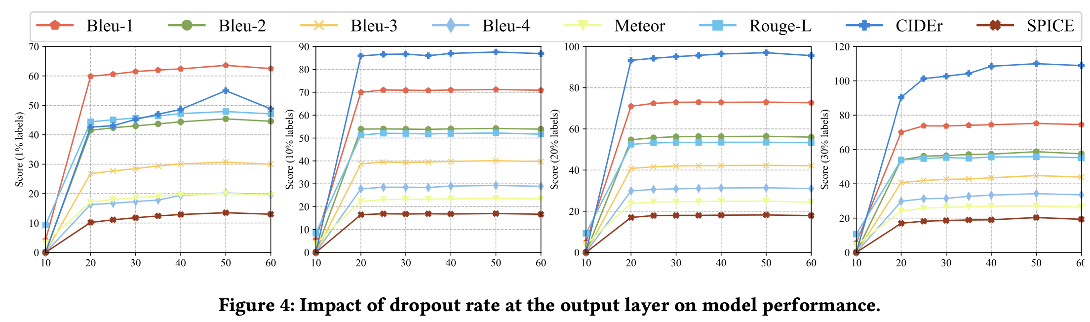
Experiment – Effectiveness of emerged language representations
Introduction
Ablation study on dropout rate in contrastive learning
Chunhui Zhang
Language representations emerge from a purely image-pretrained model
Notes:
LSTM_1 -> Hier Att -> GAT -> Hier Att -> LSTM_2

Slide 13
Look Twice as Much as You Say
Introduction
Introduction - vision language learning
Method - Scene Graph Contrastive Learning
Experiment - effectiveness of emerged language representations in image-pretrained model on captioning
Discussion - conclusion and hypothesis
Chunhui Zhang
Language representations emerge from a purely image-pretrained model
Notes:
This section, cover edge-level data efficient learning for three types of graph mining tasks.

Slide 14
Discussion
Introduction
Conclusion
Language representations can emerge from a purely image-pretrained model, even on small model in this work (i.e., LSTM_1 -> Attention -> GAT -> Attention -> LSTM_2).
Although the image captioning model only has pseudo sentence logits in the calculation of contrastive loss, the pre-trained model weights provide an effective initialization (i.e., 1% label finetuning brings impressive caption performance).
Hypothesis - for potential future exploration
LSTM brings architecture prior related to NLP: it projects the image representation to the language dimension in a sequential manner like sentence.
GAT introduces semantic representations: it extracts scene graph representation as one of the inputs to LSTM, which encodes object attributes and relations in images and enhance the semantic/language representations learned by LSTM.
Chunhui Zhang
Language representations emerge from a purely image-pretrained model
Notes:
LSTM_1 -> Hier Att -> GAT -> Hier Att -> LSTM_2

Slide 15
Thank you!
Q & A
Chunhui Zhang
Language representations emerge from a purely image-pretrained model
Notes:
LSTM_1 -> Hier Att -> GAT -> Hier Att -> LSTM_2

